Slide 1










Innovation Practices
Final Review

Slide 2
Team members
Indra Shekar G (19z219) Sanjai M (19z241) Soumen Saha (19z245) Vivekanandhan (19z261) Manoj S (19z263)
Mentor
Ms. A. Bharathi, Asst. Professor Department of Computer Science and Engineering, PSGCT

Slide 3

Industry - ShlokLabs
SHLOKLABS is a software and web/mobile development company headquartered in Lisbon, Portugal, founded in 2003. It aims to provide the best solutions for complex business problems.

Slide 4

Presentation Flow
1
Introduction
4 Methodology
2
Literature Survey
Modules Completed
5
3
Hardware and software requirements
6 References

Slide 5

Problem Statement
Healthcare Document Data Capture
Capturing content and particulars in any type of pharmaceutical bill with any format and converting it into a formatted invoice

Slide 6

Abstract
Digitizing the bills will help both sellers and customers in future needs and will reduce the use of paper in the daily needs
Text extraction from any handwritten document tends to have problems when it comes to accuracy.
Tricky handwriting - some characters look similar, making it hard to recognise for both humans and computers.
In the case of handwriting recognition from photos, there could be also obscuring angles to consider, making it harder for the computer to identify.

Slide 7

Objective
•To create character and word based neural network models using the available datasets like IAM dataset. Evaluate the models with their accuracies and picking the best one.
•Pre-process the input invoice image using OpenCV and converting it into formatted digital document using the model we created.
•Then extracting the whole text from the digital document using existing models like pytesseract, vision, etc.

Slide 8

Literature Survey
Some of the previously used models for text recognition
1. Tesseract OCR:
Tesseract is a OCR engine developed for printed text extraction. So, for handwritten text recognition, it is more challenging because of the high variation in the handwriting styles from person to person. Hence Tesseract can not achieve satisfying results unless the texts are hand-printed.
Hence the next improvement for the model should be in capturing the features and varying patterns in different handwriting styles.

Slide 9
Literature Survey
Some of the previously used models for text recognition
2. Google’s Cloud Vision:
Google Cloud Vision is an API from google for extracting handwritten text. Cloud Vision offers pre-trained machine learning models which are very powerful and we do not need any pre-training. Since it is specially made for handwritten text recognition, it will do a much better job in extracting text from images than Tesseract.
3. Recurrent Convolutional Neural Network:
CRNN is a combination of CNN, RNN, and CTC (Connectionist Temporal Classification), loss for image-based sequence recognition tasks, such as scene text recognition tasks and OCR. This neural network architecture integrates feature extraction, sequence modelling, and transcription into a unified framework.

Slide 10
Literature Survey
Some of the previously used models for text recognition
4. VGG-19:
VGG-19 is a 19-layer deep Convolutional Neural Network (CNN). It is pre-trained model trained on more than a million images from the ImageNet database. 5. RESNET-18: RESNET is a 18-layer deep Convolutional Neural Network used for object detection. 6. RESNET-34: RESNET- 34 is a 34 layer Convolutional Neural Network that can be utilised as a state-of-art image classification model.

Slide 11
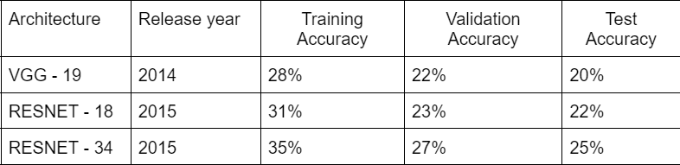
Literature Survey

Slide 12
Dataset Description
Dataset used: IAM Dataset
The IAM Handwriting Database 3.0 :
657 writers contributed samples of their handwriting
1,539 pages of scanned text
5,685 isolated and labeled sentences
13,353 isolated and labeled text lines
1,15,320 isolated and labeled words

Slide 13
Hardware and Software Requirements
Hardware Requirements
Windows or Linux OS with 16GB ram
01
02
Nvidia high end GPU
03
Minimum i5 intel Processor
04
Uninterrupted internet for Colab

Slide 14
Hardware and Software Requirements
Software Requirements
Python IDE or Jupyter notebook with the following packages
01
Pandas
Pytesseract
02
03
Open CV
TensorFlow
04
05
Matplotlib
NLTK
06

Slide 15
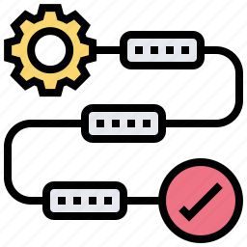
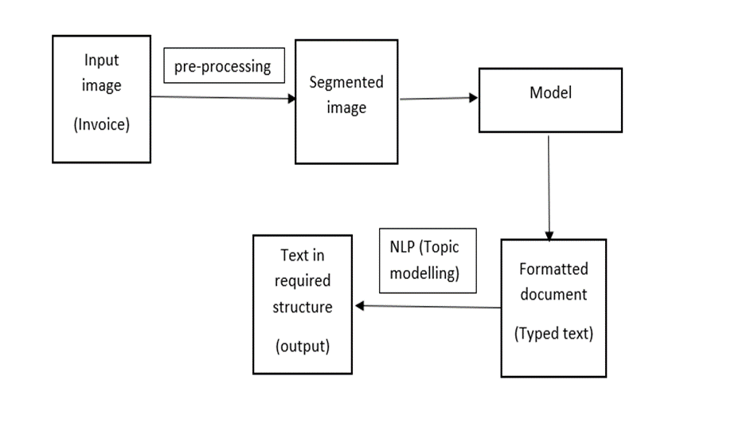
Methodology

Slide 16
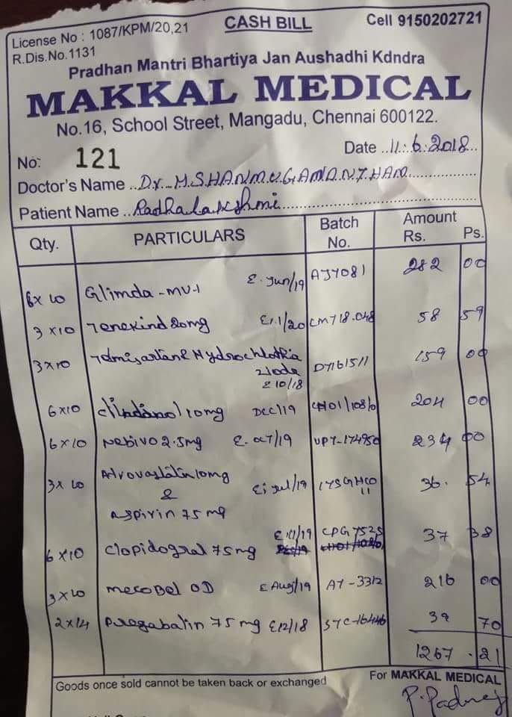
Methodology
Input format: Images of handwritten words with their labels.
Image Pre-processing: Nine pre-processing techniques imported from OpenCV and applied on the digital images (Pharmaceutical bills’ images).

Slide 17


Pre-Processing Techniques Used
1
3
5
7
9
Colored image to grayscale
Thresholding
Morph
Skew Correction
Boxing
2
6
4
8
Noise Removal (blurring)
Canny edge detection
Template matching
Erosion

Slide 18
Methodology
CRNN :
Convolutional Recurrent Neural Network
CNN + RNN
Formatting the Output:
The output will be individual words.
The extracted bills will be stored in a list and topic modeling and NLP operations are done to all the words to segregate the specific words.

Slide 19
Modules Completed
Pre Processing
Model Training
Model Testing

Slide 20
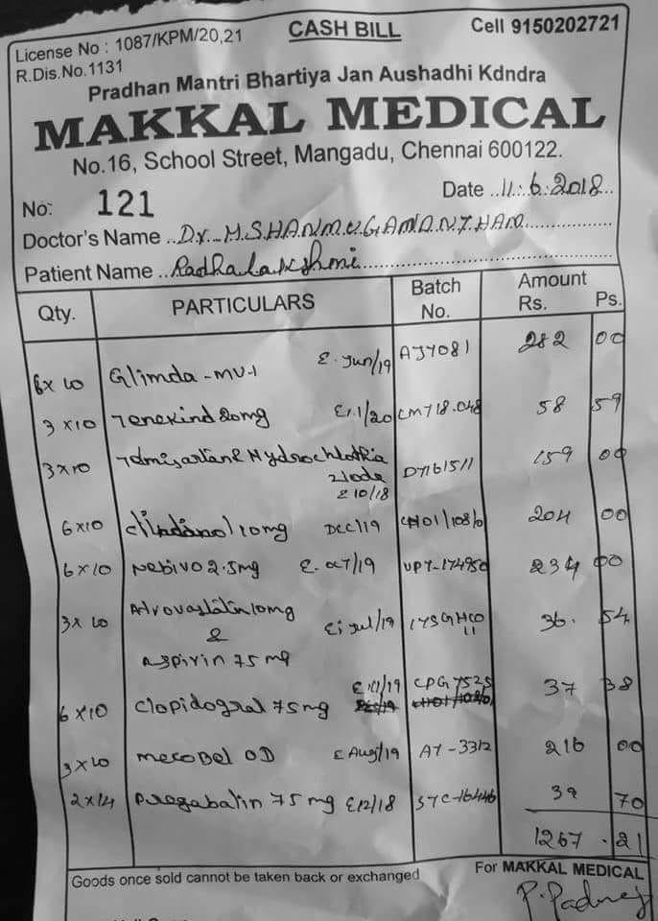
Progress
1. Pre-processing of bills
1.1 Normal bill image to grayscale image:

Slide 21
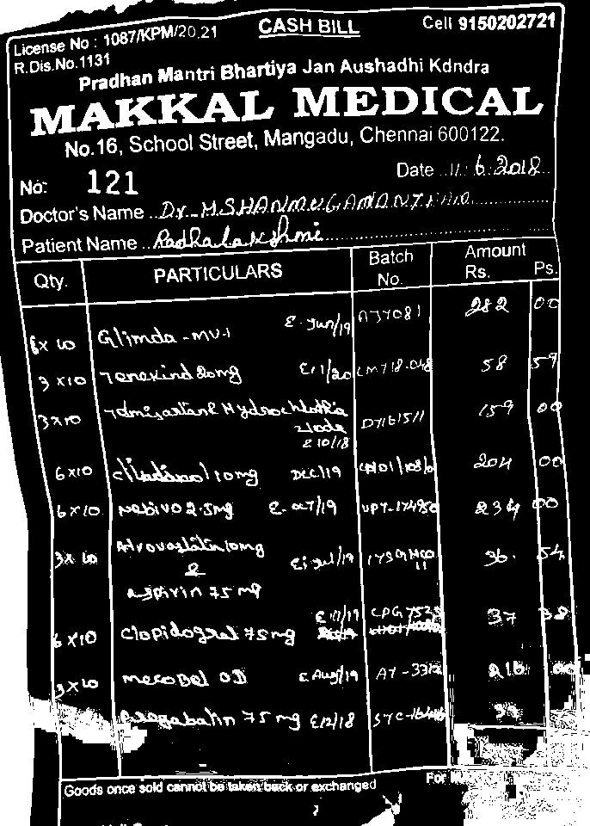
1.2 Grayscale to binary conversion using thresholding

Slide 22
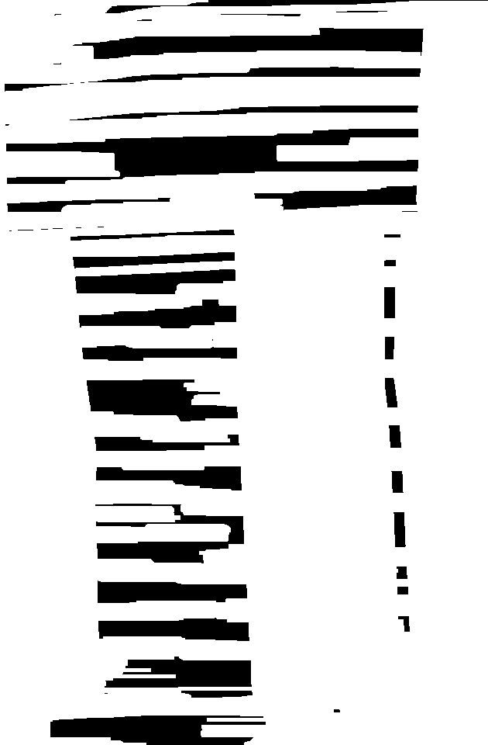
1.3 Binary to dilated image

Slide 23
2. Extracting text from the image using Keras - OCR
Keras-OCR provides out-of-the-box OCR models and an end to end training pipeline to build new OCR models.
Here, Keras-OCR is used to detect the text from the image and extract them into individual word images.

Slide 24
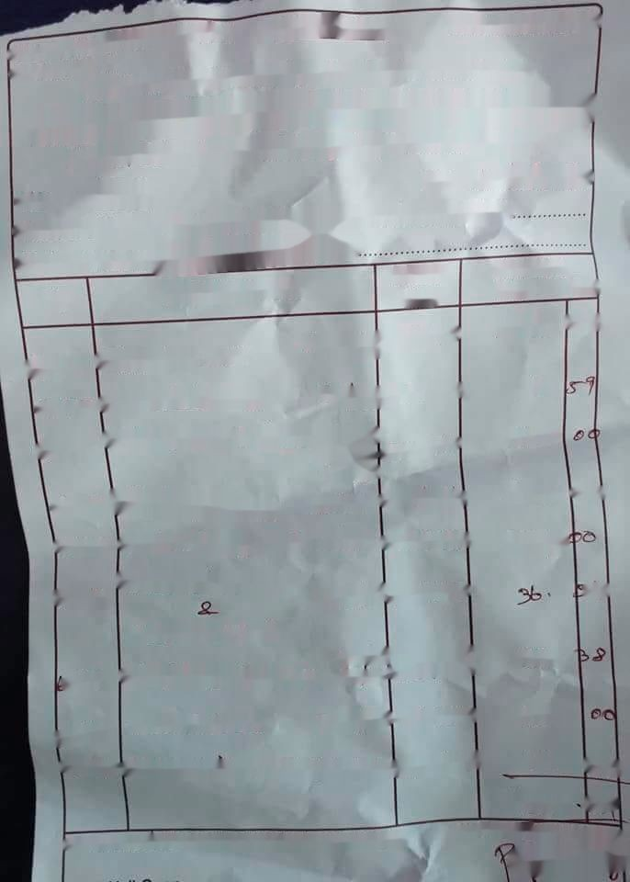
2. Extracting text from the image using Keras - OCR
Original image
After text extraction

Slide 25












Individual word images retrieved:

Slide 26
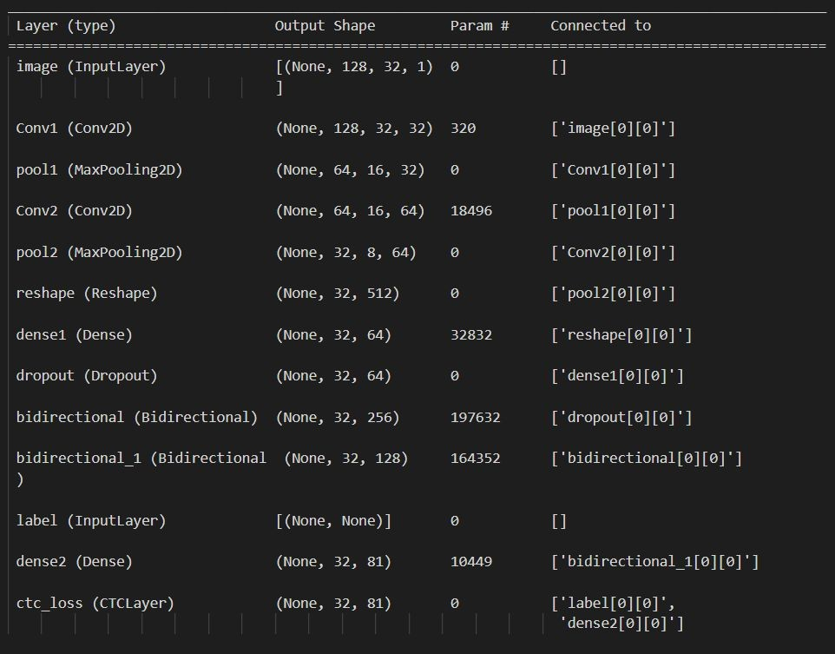
3. MODEL TESTING
Model used: CRNN
Dataset: IAM Dataset
No. of epochs: 50

Slide 27
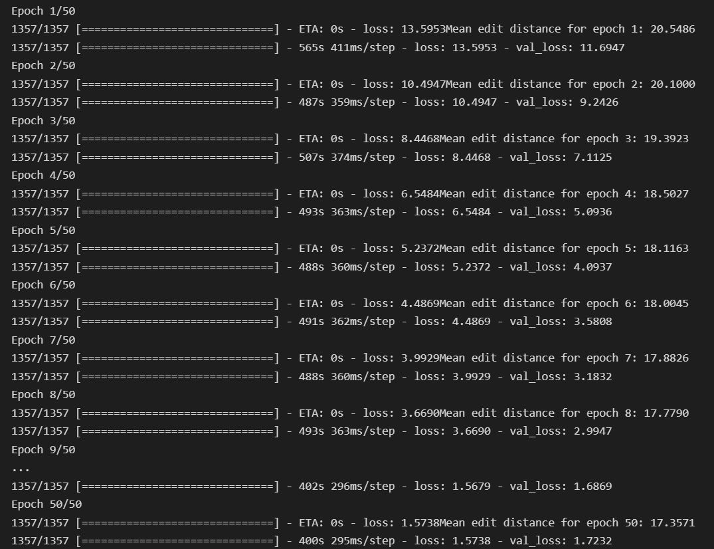

Slide 28
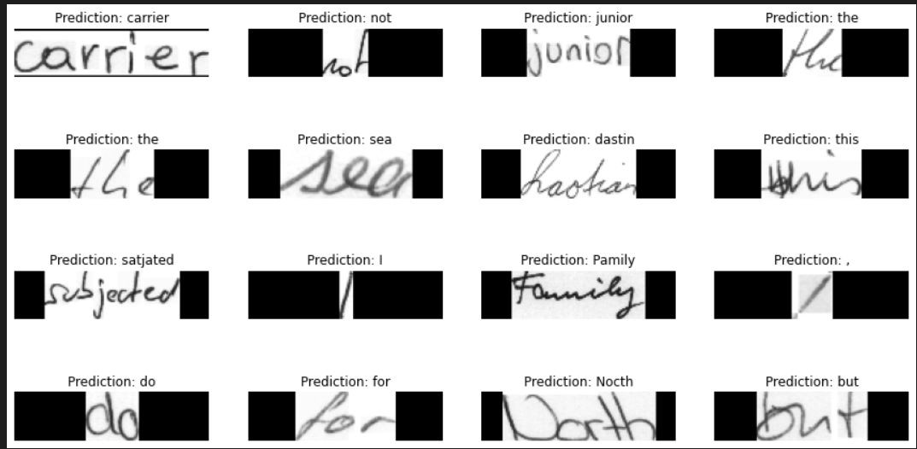
Word Predictions:

Slide 29
Project Takeaway
Keras OCR
to detect the text from the image and extract them into individual word images
Open CV
Pre processing Techniques
CTC Loss
Connectionist Temporal Classification Loss
CRNN
Individual models (CNN & RNN) were previously used
CRNN - New

Slide 30
References
https://blog.hexstream.com/process-handwritten-text-using-python-and-cloud-vision
https://medium.com/@derrickfwang/printed-and-handwritten-text-extraction-from-images-using-tesser act-and-google-cloud-vision-api-ac059b62a535
https://github.com/DerrickFeiWang/HandwritingRecognition_GoogleCloudVision
https://towardsdatascience.com/build-a-handwritten-text-recognition-system-using-tensorflow-2326a34 87cd5
https://www.researchgate.net/publication/346701461_End-to-end_Handwritten_Paragraph_Text_Reco gnition_Using_a_Vertical_Attention_Network
https://keras-ocr.readthedocs.io/en/latest/examples/using_pretrained_models.html
https://towardsdatascience.com/remove-text-from-images-using-cv2-and-keras-ocr-24e7612ae4f4

Slide 31



Thank You

